Slide 1
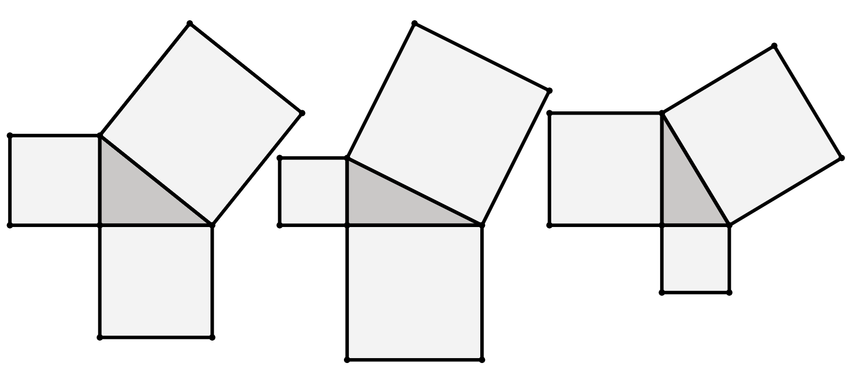
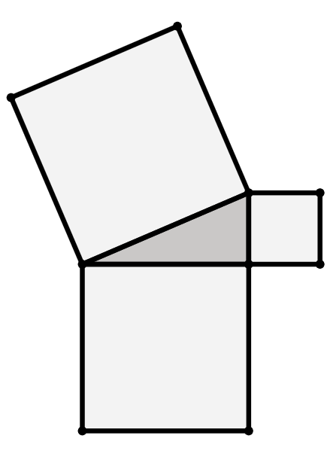
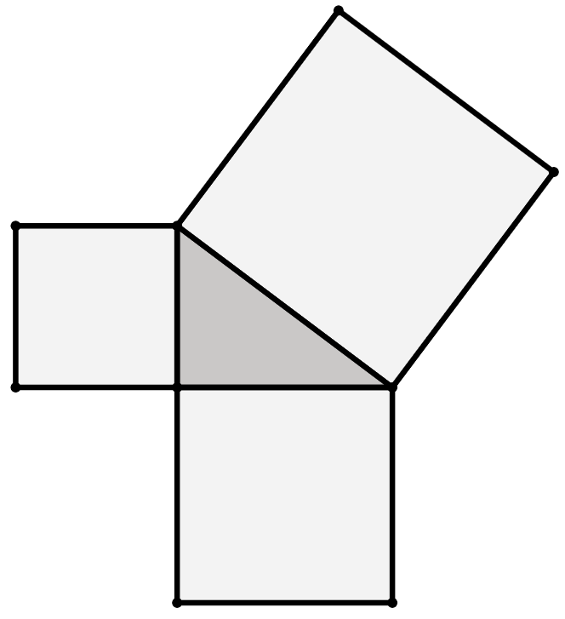
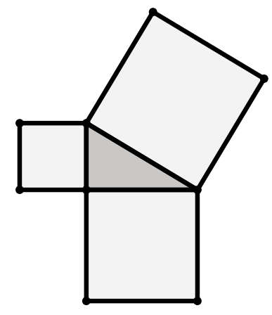
Length of the hypotenuse
Task A: Squares from the sides of a triangle
1) Find the area of each square.
a)
b)
c)
area
30 cm²
area
42 cm²
3 cm
area
15 cm²
6 cm
1 cm
2) Find the length of the hypotenuse of each triangle.
a)
b)
c)
area
41 cm²
9 cm
12 cm
10 cm
area
103 cm²
area
69 cm²

Slide 2
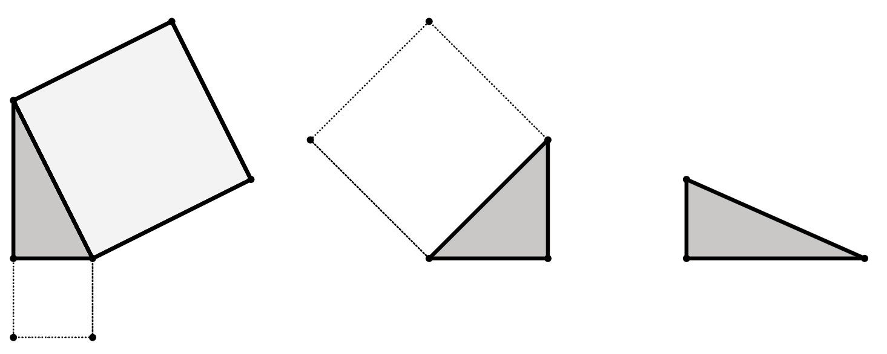
Length of the hypotenuse
3) By drawing on any missing squares first and calculating their areas, find the length of the hypotenuse of each triangle.
7 cm
a)
24 cm
20 cm
21 cm
18 cm
b)
c)
area
76 cm²
Task B: Pythagoras’ theorem to find the hypotenuse
1) This is a right-angled triangle.
Pythagoras’ theorem can be written as c² = a² + b², where c is the hypotenuse of the triangle.
Fill in the blanks to complete the Pythagoras’ theorem equation for this triangle.
2
2
2
61 cm
=
+
11 cm
60 cm
2) Show that the hypotenuse of this triangle is 17.2 cm (1 d.p.)
hypotenuse
2
+
2
10 cm
14 cm

Slide 3
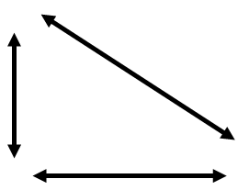
Length of the hypotenuse
3) Match each triangle to its corresponding square of the hypotenuse and length of the hypotenuse.
a)
b)
5 cm
c)
13 cm
12.2 cm
11 cm
7 cm
12.1 cm
2 cm
10 cm
173 cm²
149 cm²
146 cm²
e
f
d
h
i
g
13.2 cm
12.1 cm
12.2 cm
4) All these triangles have two lengths that sum to 64 cm.
Starting with the shortest, put the hypotenuses of the triangles in order of length.
a)
hypotenuse w
32 cm
32 cm
b)
hypotenuse x
28 cm
36 cm
c)
43 cm
hypotenuse y
21 cm
d)
hypotenuse z
54 cm
10 cm
Mathematics in Education and Industry.

